Slide 1

Introducing RSF
Antranig Basman,
CARET, University of Cambridge

Slide 2

Introducing RSF
What is it, Doctor??
RSF is a web programming framework, with roughly the
same scope as Sun’s JSF – it takes care of:
Locating and rendering views
Managing server-side and client-side state
Handling and abstracting the request cycle
It does NOT take care of:
What lies behind your data model (ORM)
Hibernate & co are highly developed solutions to this which
RSF aims to facilitate, not replace.

Slide 3

Who is it aimed at?
People developing webapps that:
  Need to be highly economical with resources (server memory and CPU)
  Have a diverse set of picky customers who want to change Look&Feel at the drop of a hat
  Have a development team with a diversity of skills (designers, coders, and end users)
  They expect to be maintaining a long time.
Unsurprisingly, a very good fit for
Universities and educators.

Slide 4

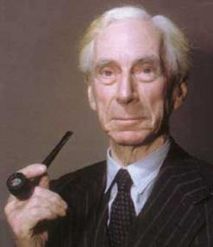
What’s new about it? – 1
RSF is the first web framework with a complete separation of presentation and logic
The aim is to make the reskinning job as close to possible
just a matter of editing HTML files, which ideally could
even by done by the end user, e.g. in Dreamweaver.
Logic in HTML is a hazard since it is not only a maintenance liability, but also fragile in the loop which passes UI around between users, designers, UI consultants, and coders
IKAT renderer operates on XHTML with just 1 extra tag in DTD (rsf:id)

Slide 5

What’s new about it? - 2
As well as featuring a “clean bean” programming model (like JSF), turns the request-scope environment into a fully-fledged Spring container.
The ability to resolve dependencies at request time is a crucial
step towards enabling highly configurable yet strongly cohesive
applications, as they scale up in size and complexity.

Slide 6
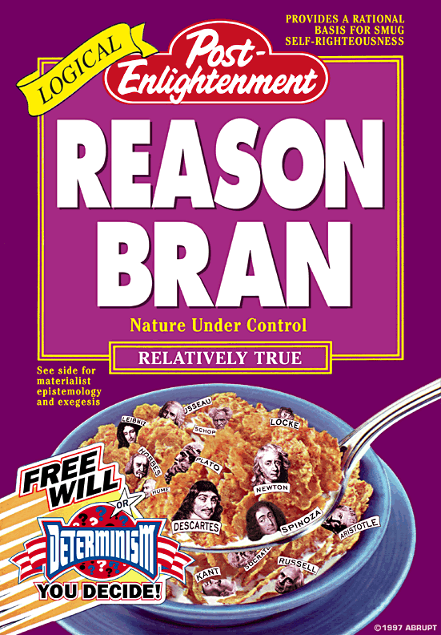
What’s new about it? - 3
Crucially, the request-scope beans implementing the domain model are reasonable, enabling
  Request-time dependence information to be encoded OUTSIDE the JVM, leading to more robust apps with an extended “bean line”
  Use of the domain model POJOs provided by an ORM solution such as Hibernate directly, even in the face of proxying/lazy properties.
(More about this slightly multi-sided idea later)

Slide 7
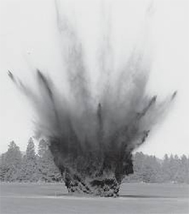
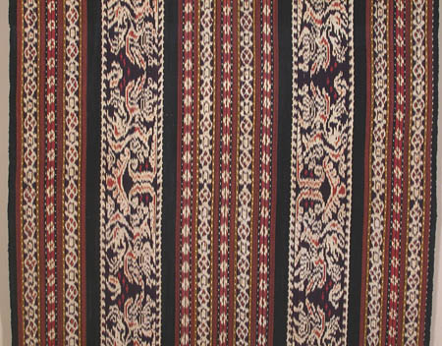
What’s in an RSF app?
Preserve
Flow
Best to look at the render cycle first.
Request
Beans
*
Restore
Errors
Alteration End
Queries
Fixups
Decode
ViewParameters
Alteration Start
Restore
Flow
processed
ViewResolver locates and produces
View
View
ViewProcessor
(fixups)
IKAT
Response
TemplateResolver locates (XHTML)
View Template
NO COMMUNICATION BETWEEN TEMPLATE AND MODEL

Slide 8
RSF Render Cycle
X(HT)ML View Template
Template lookup
View token
ViewParameters
IKAT
GET
Rendered X(HT)ML View
Request scope beans
Value Fixup
Component Tree (Logic or XML/XSLT)

Slide 9

Action cycle
The RSF Action cycle (for POST) is entirely distinct from the render cycle
Hence ready for WSRP/Portlet idioms out of the box (GET idempotency)
Automatic POST->GET redirect (for plain HTTP) keeps the browser history clean and avoids nasty user surprises.
No time to study in detail, but also contains a lightweight “Flow” implementation reading same file format as Spring Web Flow.

Slide 10
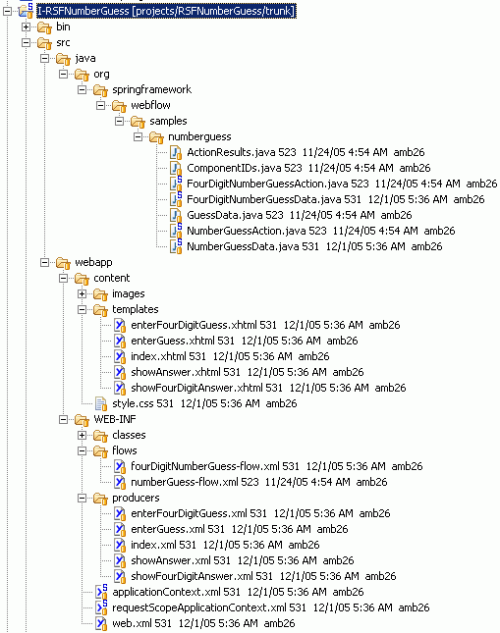
What’s in an RSF app (actually)
Code (pure beans/action handlers
– no RSF dependence)
View template files, one (or
more) per view (XHTML)
Flow definitions
(optional)
Component definition files
(XML – but could be in code)
Spring config file
Summer config file

Slide 11
Number Guessing App – the Code
This is the standard “Number Guess” app, that every framework has implemented.
One obvious difference with RSF is the “Lines of Coupled Code” count:
 | Spring Web Flow | RIFE | Struts | RSF
Total LOC | 295 | 454 | (!! - can you find them?) | 307
Coupled LOC | 172 | 192 | (however many, all) | 0

Slide 12

Number Guessing App – the Browser
Another big difference is the browser idiom. Try (in each of the frameworks)
  Pressing the browser BACK button during the game
  Pressing the REFRESH button during the game
  Attempting to start more than one game at a time
Note that for the frameworks which DO support back and refresh, this is done via “continuations”, which keeps a complete copy of the request state for EACH request made. RSF however allows “Free Flows” which duplicate as little or none of this state as you like (none is the default).

Slide 13
IKAT
OK, so how can pure HTML templating possibly work?
A kind of Javanese weaving. Most of the catchy Java-name gimmicks were taken years ago!
Observing that all view logic is (properly) just selection/repetition, the unique IKAT algorithm induces the structure of the component tree onto the template, guided by rsf:id attributes for correspondence.

Slide 14

rsf:id
The only template attribute added to the target render (XML) language.
Only three interpretations:
  simple string denotes a (leaf) component peer, e.g. UIOutput
  string containing colon denotes a container peer (UIBranchContainer), which is a function call/branch point
  string containing equals sign denotes target of static rewrite rule (e.g. URL rewrite or other runtime binding)

Slide 15
IKAT
IKAT is extremely fast.
Parse 10k template file in 5ms (almost no need to cache structures)
Render 10k document in 0.7ms (cost dominated largely by writing bytes – avoiding use of Java.io.Writer saved 25%).
Like Tapestry, the template looks EXACTLY like a rendered page, but system is much simpler. Pages can be tested “live” by web designer outside webapp complete with Javascript &c.

Slide 16
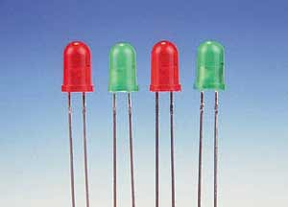
Components
Components may be generated through
  Static (ish) XML files
  Java code
  Anything else you can think of that gets this easily serializable object tree into memory.
XML files are good for apps with “big entities” and/or simple view structures
Java code is good for apps with complex view structures, or for people who just like code.
<component type="output" id="guesses">
<valuebinding>#{fourDigitNumberGuess.guessesSoFar}</valuebinding>
</component>
<component type="branchcontainer" id="guesshistory">
<component type="replicator" id="guesshistoryrep">
<valuebinding>#{fourDigitNumberGuess.guessHistory}</valuebinding>
<idstrategy type="directindex"/>
<component type="branchcontainer" id="guessline">
<component type="output" id="guess">

Slide 17
What are Components?
  Components are a “view-technology neutral” representation of the relationship between the contents of a view and the data model it is drawn with. In addition, they actually specific the contents of the view itself.
  Unlike in JSF, Components have NO behaviour (hence easily serializable). You simply fill in the fields and send them off. Also unlike in JSF, components are expected to be destroyed at the end of a render cycle (although they may not be).
  Components are very easy to write.

Slide 18
UIOutputMultiline
public class UIOutputMultiline extends UIBound {
public StringList value;
public UIOutputMultiline(UIContainer parent, String ID, String binding, StringList value) {
this.ID = ID;
this.valuebinding = binding;
this.value = value;
parent.addComponent(this);
}
}

Slide 19
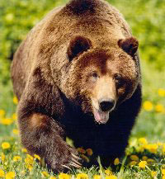
Reasonableness
What is it about the RSF bean model that makes it amenable to grizzly ORM solutions?
(Idiom) – expose the ENTIRE domain model of the app as a huge, lazily loaded HashMap, keyed by ID (reasonableness through uniform addressing)
(Framework) – provide only the bare minimum of operations for web framework to act on model – RSF EL and DataAlterationRequest.
Bottleneck all model access through the smallest possible part of the request cycle – bracketing by AlterationWrapper allows arbitrary transaction strategies. If required, DARReceiver can delay further.
(Framework) – provide the maximum possible latitude to strategies for persisting bean model elements across requests. StatePreservationStrategy and TokenStateHolder.

Slide 20
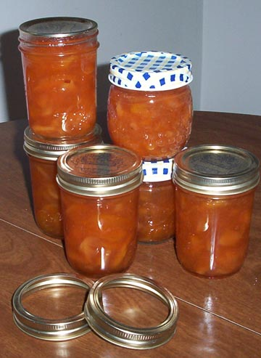
Preservation Strategies
ALL of the RSF addressible bean model is in request scope, but parts of it (completely freely selected) can live longer, through agency of PreservationStrategies.
Preservation Strategies are currently
  BeanCopyPreservationStrategy (for serializable beans, or else as part of ORM long transaction)
  RSVCPreservationStrategy (for non-serializable beans, can simulate long transaction without the pain or memory burden)

Slide 21
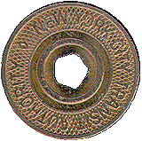
TokenStateHolder
Preservation strategy talks to a “backend” form of storage which accepts named beans of an agreed level of serializability. Some examples (not all implemented yet!) are
  InMemoryTokenStateHolder
  InHttpSessionTokenStateHolder
  InClusterTokenStateHolder
  InURLPreservationStrategy
  InFormStateHolder
  InCookieStateHolder
Server-side TokenStateHolders will cache for some selected time or until selected condition. For example, Flow scope TSH will be long-lived (like Session), whereas “Bandgap” TSH might last minutes or seconds.

Slide 22
Basically, you can do what you like
But in a properly structured environment. All of RSF is Spring-configured, so arbitrary components may be replaced via Bean Override.
RSF codebase is small and light (still only 8,000 lines and nearly finished), since it avoids implementing intrusive functionality (listeners, events, complex domain languages such as JSTL and OGNL)
A shallow learning curve with no nasty surprises waiting – an easy transition to a fully mature, code-centric solution available, even if starting from XML-based or scripted idioms.

Slide 23
Future plans
Integration with WSRP, Spring Web Flow (proper)
Alternatives for flow specification including RIFE continuations, BeanShell or lighter-weight options
Recovery of GUI-based idioms with “Auto-AJAX” – dynamic replacement of only changed panels in view during miniature request cycle. Continued avoidance of listener and event intrusion into bean model with “Bean Invalidation Model”

Slide 24
In general
Web programming should become a good deal more pleasant.

Slide 25





Acknowledgements
The CARET Team
Raymond Chan
Andrew Thornton
Dan Sheppard
Ian Boston
and
John Norman

Slide 26

Thanks for listening

